Slide 1
Space Shooter Game
Latifur Rahman Zihad
Student id: 180104

Slide 2
Introduction
Space shooter is a simple shooting game using opengl.

Slide 3
Features
It’s a shooting game about two opponent player 1 and player 2.Both of them having health initially 100.who survive he will win the game

Slide 4
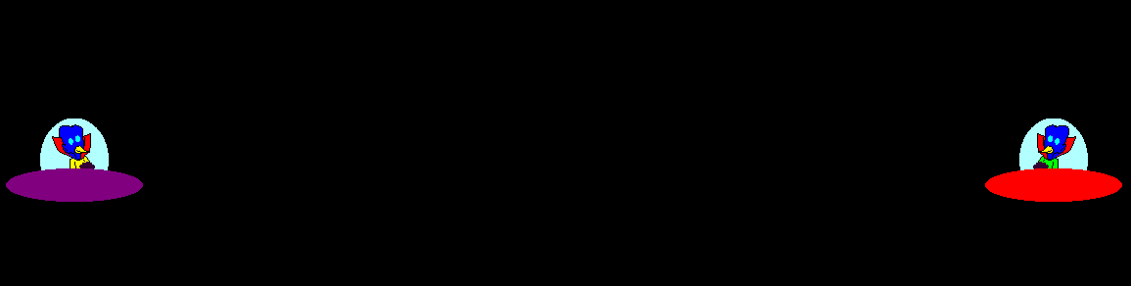
Features
This game contains two players.
Player 1
Player 2

Slide 5
Features
Both of the player can go up and down.

Slide 6
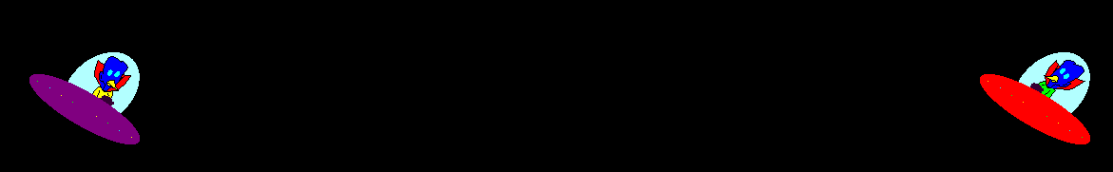
Features
Both of the player can rotate also.

Slide 7
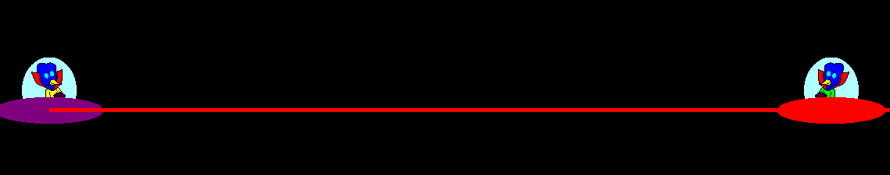
Features
Both player can fire
laser gun to reduce
opponent heath.

Slide 8
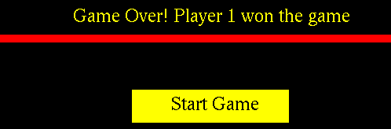
Features
If any player finally survive become winner.

Slide 9

Implementation
Here on this project we use C++ opengl for implementation.

Slide 10
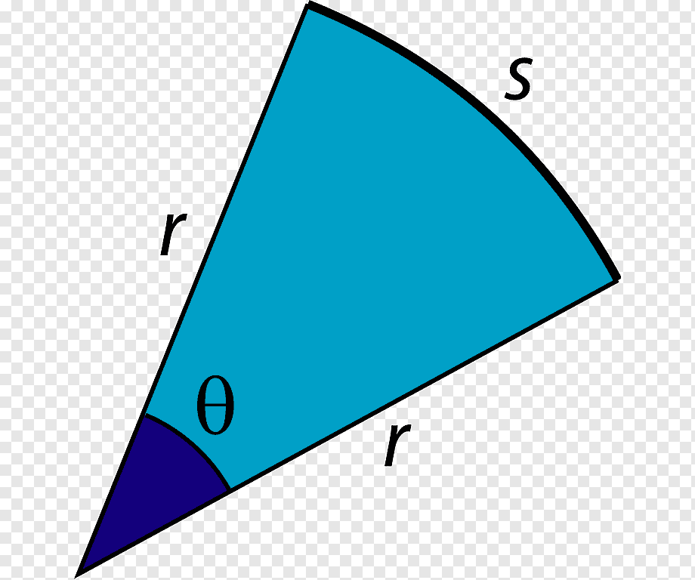
Implementation
We use various mathematical function
of trigonometry.

Slide 11
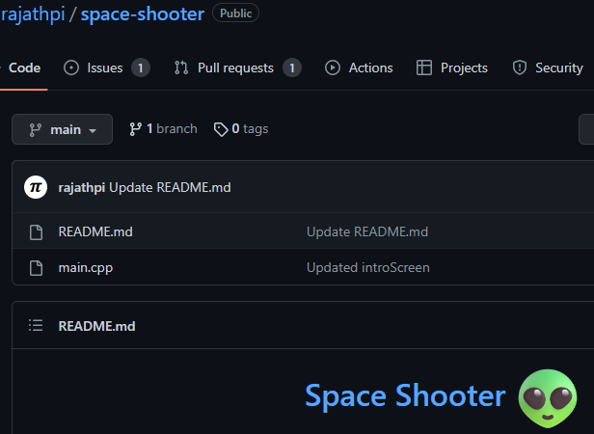
Implementation
We acknowledge rajathpi
For his contribution of
The Code.

Slide 12
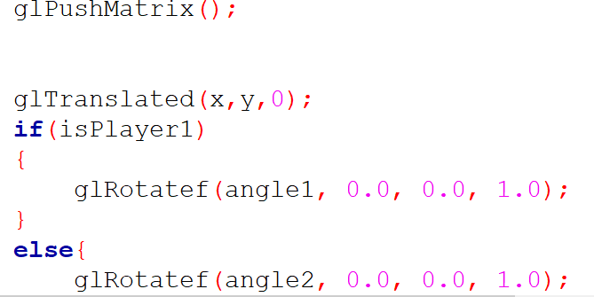
Implementation
We update the rotation of player and remove left right movement.

Slide 13
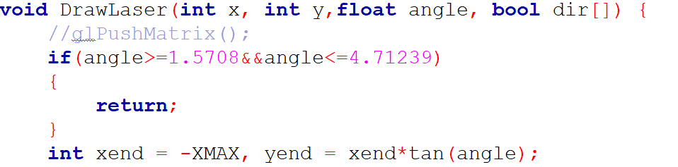
Implementation
To fire laser towards rotated direction we
use tan() and have also convert degree to radian

Slide 14
Implementation
To fire laser towards rotated direction we
use tan() and have also convert degree to radian

Slide 15
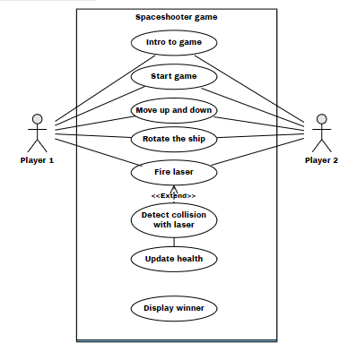
Use Case Diagram

Slide 16

Achievements
Before the course my curious mind thinks how animation and simulation can be created.

Slide 17
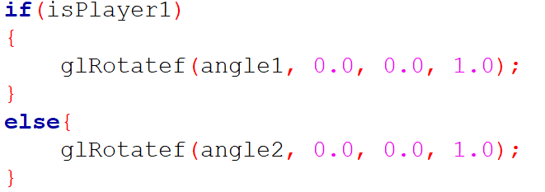
Key Function
We use glRotatef() for the solution .

Slide 18
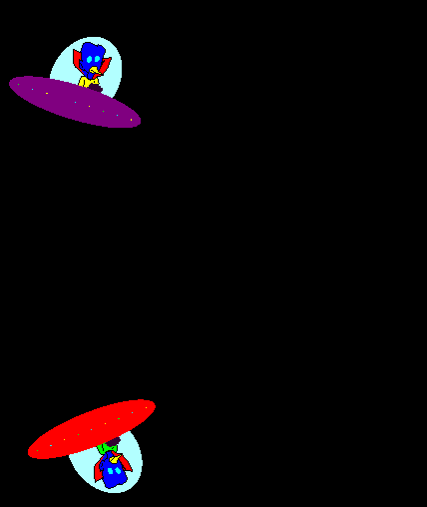
Difficulties
I faced some problem
for example.
My rotational function operates circular path
instead of rotate.

Slide 19
Difficulties
My rotated ship fire laser in wrong direction

Slide 20
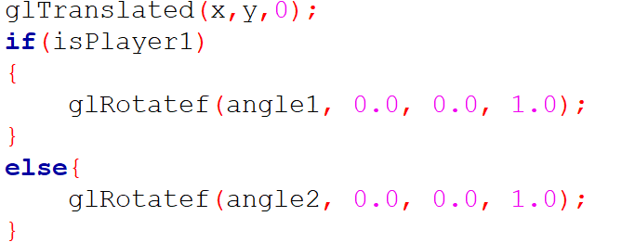
Solution
I figure out that the function position of glRotatef() is in wrong place.
I also convert degree to radian to get correct direction of laser.

Slide 21


